Slide 1
UI Tests Are Fun to Write!
Seth Petry-Johnson
@spetryjohnson
github.com/spetryjohnson
Notes:
Welcome to “UI Tests Are Fun To Write (If You Write Them Right)”.

Slide 2





































TITANIUM SPONSORS
Platinum Sponsors
Gold Sponsors

Slide 3
UI Tests Are Fun to Write!
Seth Petry-Johnson
@spetryjohnson
github.com/spetryjohnson
Notes:
Welcome to “UI Tests Are Fun To Write (If You Write Them Right)”.
Let’s start with the obligatory audience participation survey. Quick show of hands: how many of you are currently writing automated UI tests in your projects? Anyone here that used to write them, but gave up? And the last question, how many of you enjoy writing UI tests at least as much as you enjoy writing other types of tests?
I’m not going to lie, I generally dislike UI tests. They often aren’t fun to write. They are hard to set up. They’re slow to execute. They can’t be run in parallel. They make permanent changes to the database or file system which sometimes prevent the tests from being re-run without resetting to a known clean state.

Slide 4
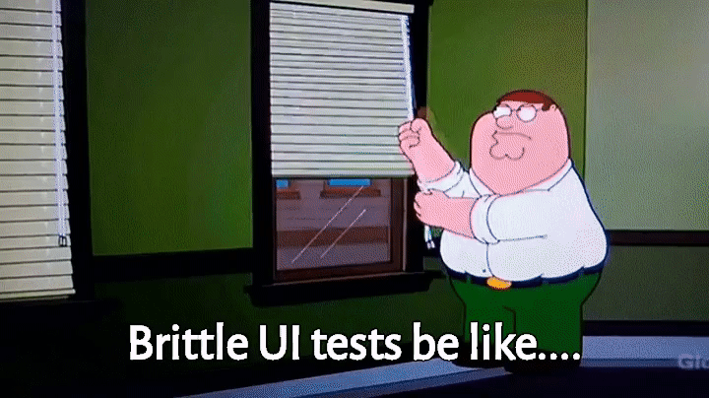
Notes:
And if you don’t write them right, they can be extremely brittle.
Even a tiny CSS change can break a whole suite of tests.
And because these tests take so long to run, triaging and fixing broken tests can be very time consuming.

Slide 5
Why bother?
Notes:
For those reasons, and many more, my team resisted writing UI tests for a long time. We’ve been producing a large and complex SaaS product for about 8 years. We’ve been writing unit and integration tests since the beginning, and we’re up to almost n7000 unit and integration tests.
You might think that with thousands of unit and integration tests, that we’d be able to very quickly release new code into production.
But if you thought that two years ago, you’d have been wrong. Unfortunately, no matter how many unit and integration tests we wrote, we kept having experiences like this.

Slide 6
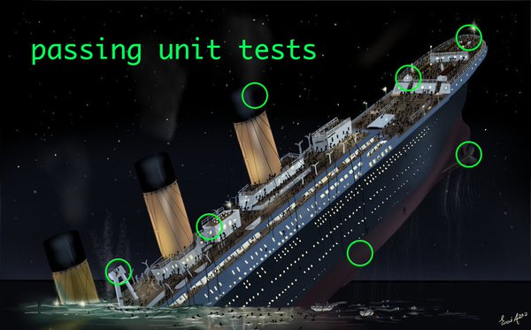
Notes:
All too frequently we’d have a bunch of green checkmarks in the test runner, and we’d push a new build into PROD, and then a user would go and do something fairly simple and they’d hit some sort of problem in the UI layer that none of those tests was able to detect.
Unit tests tell us things like “if the electrical system is working, then the lights will turn on when you press this switch”. That’s great to know when testing the switch but doesn’t really tell us that the boat will float when placed in the water.
Integration tests tell us things like “the engine correctly causes the propeller to spin at the desired speed”. Again, that’s really helpful when designing the propeller system, but again it doesn’t tell us whether or not the boat is going to actually float.
Eventually, we realized that unit and integration tests alone are insufficient to support frequent releases of a large or complex app. If we want to maintain a stable velocity over time, and if we want to avoid putting our users through experiences like this, then UI tests are a necessary evil.

Slide 7
UI tests prove stuff works where it matters: in the browser
Notes:
And that’s because only UI tests give us the confidence that our code will work correctly when a user hits the site in a browser. Only UI tests give us that reliable confidence that the boat will in fact float.
And we need that confidence to go live. There are only so many times that your users will sit patiently in those deck chairs while your ship sinks into the freezing ocean before they start travelling on a different company’s ship.
In our case, we estimate that a manual regression test of the entire application would take at least 8 man-days of extremely boring, repetitive, non-life-affirming work for our QA people. That’s 8 days that we’d need to pause or slow down our development effort so that QA could focus on something they don’t want to do and doesn’t add any new value to the bottom line.
Automating the UI tests doesn’t mean we don’t need QA at all, it just means that they can focus their energy on exploratory testing, really thinking about edge cases in the business rules, etc. Automated UI tests help us release faster and make everyone a happier camper.

Slide 8
UI tests prove stuff works where it matters: in the browser
Notes:
Unfortunately, there’s a difference between knowing the path and walking the path.
Our first attempts at UI testing were painful. We made lots of mistakes, we wrote lots of bad tests, and we spent lots of time struggling to keep them green.
But we kept at it. We kept looking for better patterns and different ways of doing things, and over time our UI tests got better.
And then, late last year, one of the new developers on my team said something that inspired me to write this talk.

Slide 9
"When I first started writing UI tests, I hated them. Now, I kind of like them. They're fun." - A developer on my team
Notes:
We were talking about our UI testing patterns and he said “when I first started writing UI tests, I hated them. Now, I kind of like them. They’re fun”.
This quote is the reason I’m up here today. It told me that, even though we still struggle with many aspects of our UI tests, and there are lots of imperfections in our approach, we’ve solved enough of the pain points that new programmers joining our team enjoy learning how we do things and no longer look for excuses to avoid these types of tests.

Slide 10

Notes:
The point of this talk is to share those practices with you.
I’m not an expert in UI testing, but my team has been grappling with these issues for the last few years and we’ve learned some things that work well for us, and they might work well for you too.

Slide 11

Notes:
The last thing I want to say up front is that there are no silver bullets in UI testing. It’s all about making trade-offs.
Some of the choices my team has made won’t work for you, and that’s cool. My hope is that if I tell you WHY we made those choices, you might be able to factor that into your own decision making on your own journey.
No matter what you choose though, it’s going to take a little hard work. It’s work that’s well worth doing.
And if you do it right, it might even be a little bit fun.

Slide 12
Today's agenda
When to use a UI test – and when not to
How we use the PageObject pattern
Creating test data with Test Helpers
Writing resilient tests
Notes:
That’s probably enough stage-setting, so let’s get into some details.
In this session you’ll see:
- How we decide when to write UI test, and when not to
- How we use the PageObject pattern to write and organize our UI tests
- How we deal with test data
- Some tests for making your UI tests more resilient to change
What you will NOT see are introductory slides about how to actually get started with Selenium WebDriver, which is the API that we use to automate the browser. If you don’t already know how to automate the browser via code, that’s fine; you don’t need to know that to get value from this session. I’m going to focus on concepts and patterns and strategies because that’s what I think determines if you’re going to be successful with UI testing or not.

Slide 13
When should you write a UI test?
Notes:
The first thing I want to talk about is when you should, and should not, write UI test.

Slide 14
When should you write a UI test?
Only when you can't write a test instead
Notes:
And the simple rule is that you should write a UI test only when you can’t write a cheaper, faster, easier test that can give you the confidence that you desire.
Or, put another way, the surest way to guarantee that your UI tests aren’t fun to write is to use them to test the wrong things.

Slide 15
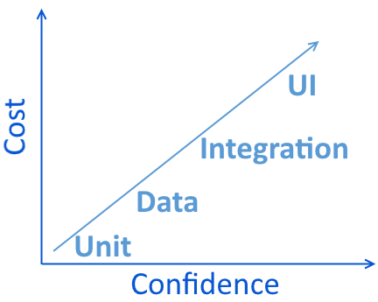
Types of Tests
UI / Functional
Integration
Data
Unit
Notes:
My team differentiates between these 4 types of tests, and each type of test involves a different trade-off between the cost to author or maintain that test and the confidence that it gives us about the system.
Unit tests are generally easy to write and cheap to execute, but because they tend to test things in isolation, they don’t give us a lot of confidence in the overall system.
UI tests give us lots of confidence about the system, but they’re hard to write and costly to execute. And there are varying degrees of trade-offs in the middle.
Whenever we set out to write a test, the first thing that we ask ourselves is “what is the lowest test type on this list that could conceivably test the code in question”? And if the answer to that question is “UI test”, then the very next question we ask is “how can we refactor the code to change that answer?”

Slide 16
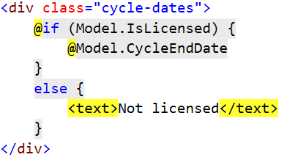
Refactor UI code to make it unit-testable
Notes:
Here’s an example.
A common scenario we encounter is a requirement that some piece of information is hidden or visible based upon some other condition.
My application deals with licensing and credentialing, so the My Account might have a piece code that says that if the current user has an active license then the end date for their license cycle should be displayed. If the current user isn’t licensed, we show some default text instead.
If this rule is important enough that it justifies a test, then the only way to do that is through a UI test, and the UI test would look like this:

Slide 17
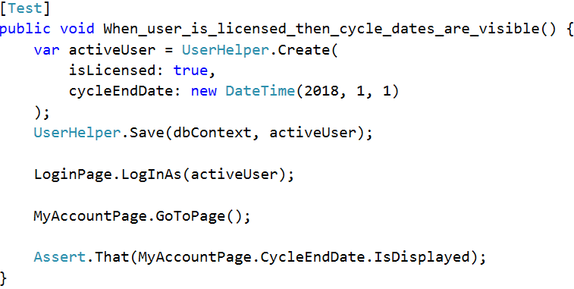
Refactor UI code to make it unit-testable
Notes:
I’ll talk about some of these patterns in more detail in a little bit, but for now the point is that in order to test that one tiny piece of logic in the view code we’d have to create a new user object, save it, spin up the browser, log in as that user, navigate to the My Account page, and then use Selenium to determine if the cycle date is visible.
That’s a lot of setup work to test a tiny piece of logic!

Slide 18
Refactor UI code to make it unit-testable
Notes:
We’ll probably also want to test the negative case, in which the dates do NOT show up if the user is not licensed, which means creating a second copy of this test and having a second UI test repeat the whole process.
This is NOT the appropriate way to test logic like that.

Slide 19
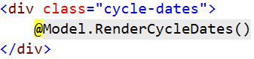
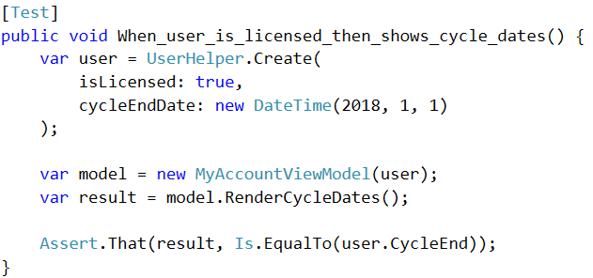
Refactor UI code to make it unit-testable
Notes:
A better approach is to move that logic out of the view and into a method on the view model, and then write unit tests against the model.
This test is thousands of times faster than the UI test because it executes entirely in memory, and it’s easier to write because you’re not dealing with test data or login credentials or anything else.

Slide 20
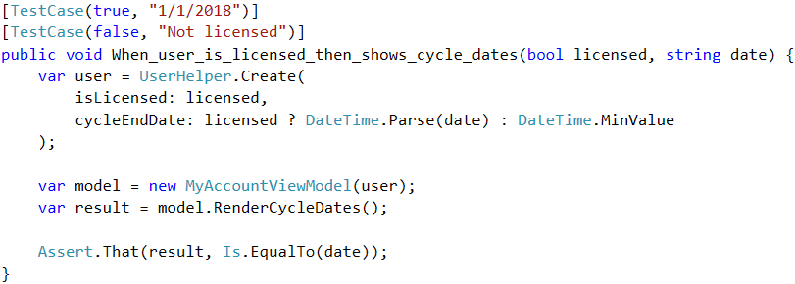
Refactor UI code to make it unit-testable
Notes:
Extracting code into unit tests really pays off when you’re testing multiple permutations of something.
In this case, I’ve written a single test that has been parameterized to cover both the scenario when the user IS licensed, and when they’re not. This allows me to reuse the same setup code which makes these tests easier to write and maintain.
To be fair, you can write parameterized UI tests as well, but it gets hairy if those tests have to create or modify data because you end up with multiple tests, each trying to make the same permanent changes to the database. Unit tests don’t have any of those constraints.

Slide 21
Types of Tests
Use unit tests for…
Property-based testing of view models
Parameterized test cases
UI / Functional
Integration
Data
Unit
Notes:
The general point I’m making is that any time that you can refactor your code so that you can unit-test a view model, rather than UI test your DOM, that’s probably something that you should do.
This technique isn’t always a good approach. A code-based unit test won’t detect if a certain string is being output, but then hidden with CSS, or removed from the DOM with JavaScript. That’s where your critical thinking comes into play – if the feature in question is on a highly dynamic page with lots of client-side complexity then maybe a UI test makes sense.
But if the feature in question is a simple HTML details page then you’re much better off keeping your views simple and stupid and putting formatting and calculation logic where it can be unit tested instead.

Slide 22
Types of Tests
MVC Controller
View Model
Service Class
Data Component
Integration test (no mocks)
Data test
UI / Functional
Integration
Data
Unit
Notes:
If we want more confidence in the system than we get from a unit test, the next best thing we can do is get rid of all the mocks and start testing things against a real database and in collaboration with each other.
Many teams will say that any test that hits a database is an “integration test”. On my team, I differentiate between “data tests” and “integration tests” because it helps us be more explicit about coverage.
The difference between them is what layer of the stack they target. A data test is basically a unit test of the data access layer, and an integration test calls something higher in the application stack.

Slide 23
Types of Tests
Use data/integration tests to validate…
UI / Functional
Integration
Data
Unit
Database updates
File system changes
Email delivery
Any externally-visible side effects of a piece of code
Notes:
If we want more confidence in the system than we get from a unit test, the next best thing we can do is get rid of all the mocks and start testing things against a real database and in collaboration with each other.
There are all kinds of things that you can test for using integration tests that don’t require spinning up a browser:
Database changes
File system updates
Email delivery
Really, any code that has an externally visible side effect outside the browser itself can, and likely should, be tested with an integration test instead.

Slide 24
Types of Tests
Use data/integration tests to validate…
UI / Functional
Integration
Data
Unit
Database updates
File system changes
Email delivery
Any externally-visible side effects of a piece of code
Notes:
In fact, the vast majority of our tests that validate true business-logic are data or integration tests. We deliberately write that logic so that we’re able to test it without exercising the UI.

Slide 25
Types of Tests
UI / Functional
Integration
Data
Unit
Notes:
That brings us, finally, to UI tests, which are the most costly tests we write, but also the ones that give us the most confidence.
I already said that we use unit tests against a view model to check for calculations and visibility of certain data, and that we use integration tests to validate most of our business logic.
So what does that leave for UI tests to focus on?
Well, we try to only write UI tests for things that cannot be tested any other way. And if you think about it, there are lots of things that are difficult to test without standing up the full web stack, hitting it with a browser, parsing the HTML, and executing the JavaScript.

Slide 26
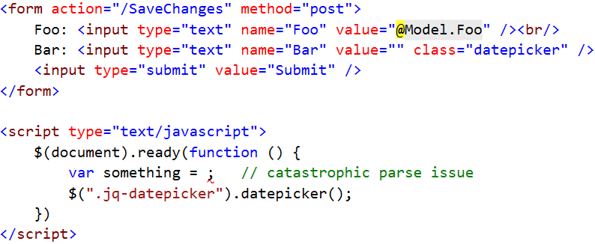
Types of Tests
UI / Functional
Integration
Data
Unit
Notes:
Let’s say you have a simple Edit page. Someone clicks on a link and hits an endpoint and the system returns an HTML form. The person makes changes to the form and clicks submit, and then the form gets POSTed to another endpoint where the form data is processed in some way. Think about all of the things that could go wrong:

Slide 27
Types of Tests
UI / Functional
Integration
Data
Unit
Notes:
Maybe the code that renders the form doesn’t initialize its default values to match the thing being edited, so the form renders but the fields are blank.

Slide 28
Types of Tests
UI / Functional
Integration
Data
Unit
Notes:
Maybe the form uses a jQuery plugin for one of the fields, but there’s a syntax error in some JavaScript and it causes the JS engine to abort before the plugin is fully initialized.

Slide 29
Types of Tests
UI / Functional
Integration
Data
Unit
Notes:
Or maybe someone changed a CSS class on a field, but didn’t update the JS to match so the plugin doesn’t actually do anything.

Slide 30
Types of Tests
UI / Functional
Integration
Data
Unit
Notes:
Or maybe the <form> tag has a typo in the action element and points to an invalid location, or maybe the endpoint it posts to has been renamed but the form wasn’t updated

Slide 31
Types of Tests
UI / Functional
Integration
Data
Unit
Notes:
Or maybe the field names on the form don’t match up with the payload the endpoint is expecting, so even though the user’s changes are sent to the server, they end up getting ignored.

Slide 32
Types of Tests
Use UI tests for…
UI / Functional
Integration
Data
Unit
Validating that all UI elements work together
Testing user interaction rather than business rules
Notes:
These sorts of things are impossible to catch without using a browser, so that’s what we focus UI tests on.
We rarely, if ever, write UI tests to validate back-end business rules; it’s all about testing user interaction with the UI.

Slide 33
Setting up a UI test
Initial State
Initial Navigation
Assert()
Who's Logged In?
Notes:
Once you’ve decided that you have something worth testing via the UI, you need to write the actual test. Every UI test needs to consider 4 things:
What baseline data needs to exist before the test can run?
What user identity will be used to perform the test?
How does the test navigate to the “starting page” or context from which the test begins?
Once the browser is on the target page, how do we write good, clean, maintainable test code?
There are trade-offs and interesting challenges in each of these areas. I’m going to start with the test code itself, and work my way backwards.

Slide 34
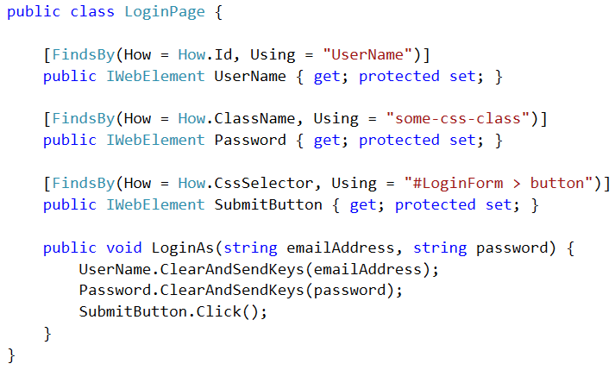
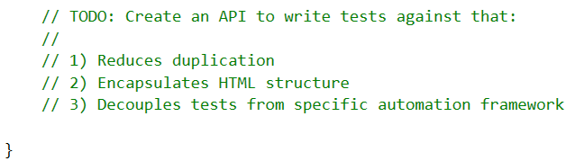

PageObject
Notes:
Like many teams doing UI testing, we organize our tests using the Page Object pattern, so we create a PageObject class for every page or UI component that we want to test.
In this case, I’ll be showing you the PageObject for a Login page.
The point of a PageObject is to create an API that your UI tests can use to interact with that page. The idea is that by writing tests against this API they’ll be cleaner, have less duplication, and be less tightly coupled to any one specific automation framework.

Slide 35
PageObject
Notes:
The first thing that we do in these PageObjects is create public properties representing the HTML elements on that page.
For instance, this is a Login page so it has a username field, a password field, and a button to submit the form.
How you actually implement these properties will depend on the specific browser automation tool that you’re using. We use Selenium WebDriver which gives us…

Slide 36
PageObject
Notes:
…this handy FindsBy attribute which allows us to declaratively bind each property to the DOM using different types of selectors.
The idea here is that whenever a piece of code references the UserName property, WebDriver will go out to the DOM and find the element with the UserName ID, and then return an instance of this IWebElement that acts as a proxy to that DOM element.
Our most commonly used selector type is an ID selector like you see here, but we also frequently use…

Slide 37
PageObject
Notes:
… CSS class name and CSS Selector strategies as well.
I’m going to talk more about writing good selectors in a little bit, for now the main point is that the PageObject exposes its HTML elements as public properties, and if you’re using WebDriver you can use the FindsBy attribute to easily bind those properties to the DOM. All we have to do is worry about the selector and Selenium WebDriver handles the rest.

Slide 38
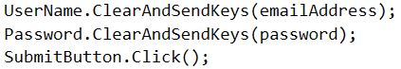

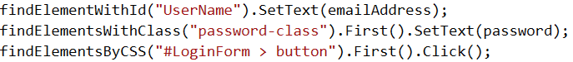
PageObject
Notes:
Using PageObject like this is an example of writing an application-centric API for interacting with the page.
An application-centric API is focused around what the elements mean and how they can be used. They allow a software client, like a test, to do anything a human being could do without knowing anything about the underlying HTML.
This is how humans interact with a website: you go to the form, you see a field called username, you type into it, and then you click submit. You don’t need to know anything about how that form is actually built in order to interact with it.

Slide 39
PageObject
Notes:
Contrast that with an HTML-centric API like you see here. In this case, test authors must have intimate knowledge of how a page is implemented in order to write a test, and changes to the HTML structure could break a large number of tests.
Following the PageObject pattern makes UI tests extremely easy to author. If you see HTML locators showing up in your actual tests, you’re very likely doing something wrong and shooting yourself in the foot.

Slide 40
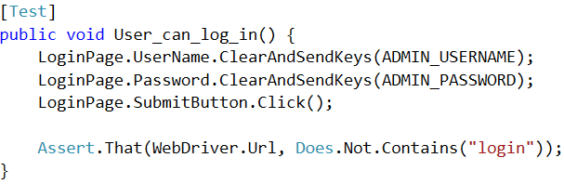
PageObject
Notes:
When we first started using PageObjects, our test code looked like this. Each test would interact with the PageObject’s properties to modify HTML elements, and then would make the necessary assertions.
Simple, right? We’ve definitely decoupled this tests from the HTML structure, but it’s still coupled to the specific front-end implementation.

Slide 41
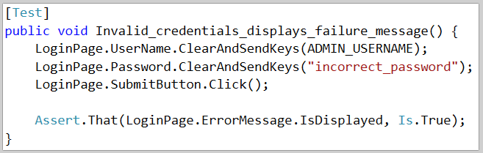
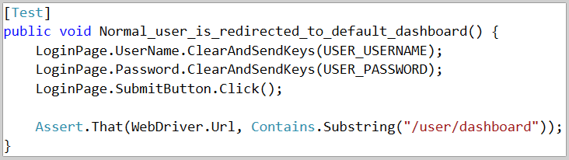
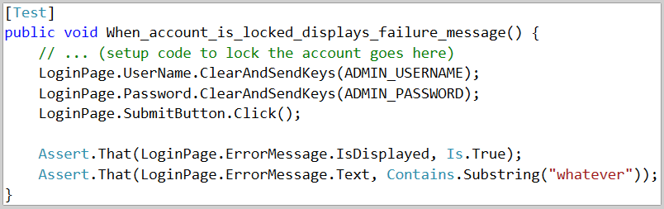
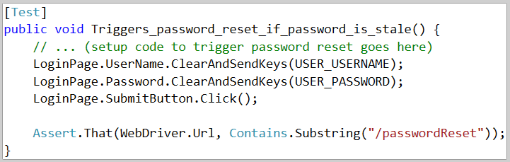
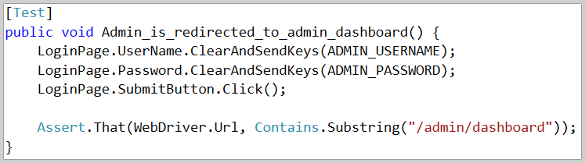
Notes:
Let’s imagine for a moment that I have five different tests I want to run for the login page:
Invalid credentials results in an error message showing up on the page
Valid credentials for a “locked” account displays an error message
Valid credentials for an Admin user causes redirect to the Admin dashboard
Valid credentials for a Normal User causes redirect to the default dashboard
If a user that hasn’t changed their password in over 180 days triggers Password Reset process
Actually, before I move on, pop quiz: can anyone tell me why these are really bad example of UI tests?

Slide 42

Notes:
It’s a bad example because these tests are covering business logic tests, not the UI. Things like “when the account is locked, don’t let user log in” should be a unit or integration test instead.
In a real-world test of a login page I’d probably have a single test that ensures that a failed login results in an error message being displayed, but I’d enumerate all of the different reasons that could cause the failure, and the specific error messages that are appropriate for each one, as lower level tests.

Slide 43
Notes:
Anyways, let’s pretend for a moment that I wasn’t being lazy in my slides and that these ARE good example of UI tests you’d want to write.
Each of these 5 tests needs to do the same 3 things: put a username in the username field, put a password in the password field, and then click submit. If we copy and paste these 3 lines in each of those 5 tests, that’s a lot of duplication.
What happens if someone in the legal department gets paranoid about cookie usage and wants us to put some checkbox on the login page that requires the user to acknowledge our privacy policy before they are even allowed to log in?
That type of change would need to be duplicated in all 5 of these tests because each test is coupled to the front end implementation.

Slide 44
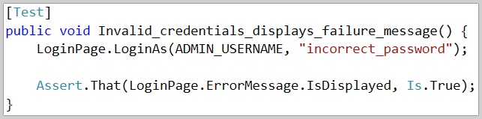
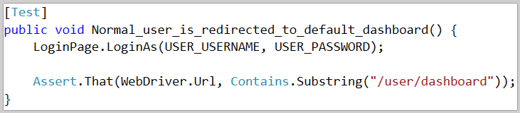
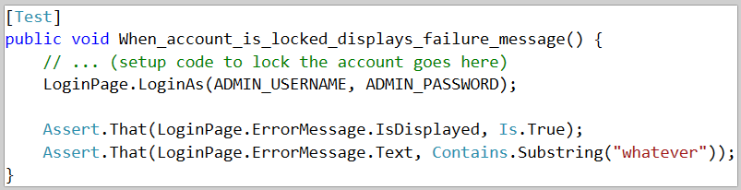
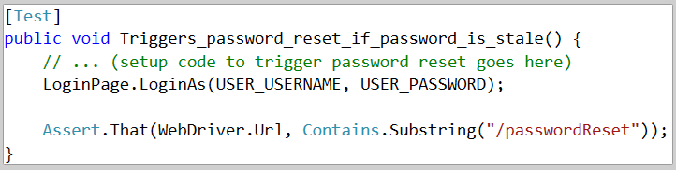
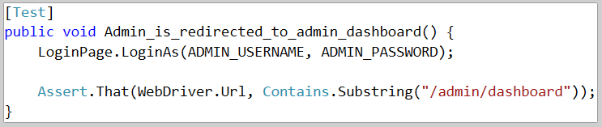
Notes:
Over time, we’ve started adding behavior to our PageObjects as well.
In the case of the LoginPage object example, we has a “LoginAs” method that takes the username and password and then encapsulates whatever steps need to be performed.
Now, any test that wants to log in can do that with one line of code, and if we need to make changes, such as adding that checkbox, we have a single place to do it.
In fact, we’ve started making most of our PageObject properties private because it forces us to expose all of the things that a page does as method calls instead. This makes the tests more expressive, more intent-revealing, and easier to maintain.

Slide 45
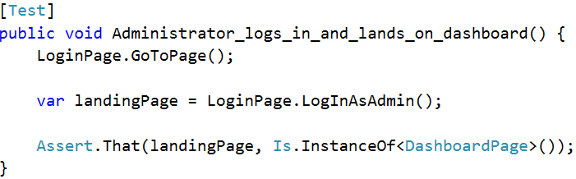
PageObject
Notes:
Another thing that we do on all of our PageObjects is to include a “GoToPage” method, which makes it easy for tests to navigate directly to that specific page or context.
When we first started writing automated tests, we did everything the exact same way that a user would... Slow tests.. It also made the tests extremely brittle. At one point in our history we had something like 50 UI tests for the admin area of our site…. Our app is extremely configurable, and one of the things that you can change is the labels… The lesson here is that every single interaction that you automate through the browser is a potential point of failure, so you really only want to automate those things that are completely necessary for your test case.
So as a result of that debacle, we started including the GoTo method on all of our PageObjects so that we can navigate directly to the page in question, rather than automating clicks against the navigation menu.

Slide 46
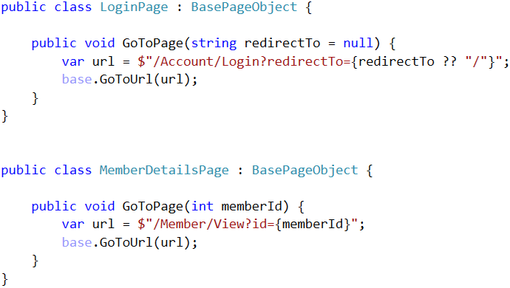
PageObject
Notes:
The other benefit of the GoToPage method is that it lets us document the required URL parameters for each page.
The login page, for example, has no required parameters but it does support an optional “redirectTo” parameter that overrides the default redirect following a successful login.
The member details page, on the other hand, requires that you specify the ID of the member you want to view.
Baking those details into the GoToPage() method ensures that our tests are never navigating to pages without the required data. And if we happen to change the set of required or optional parameters for a page, static analysis tools and the compiler will very quickly help us determine which UI tests need updated accordingly.

Slide 47
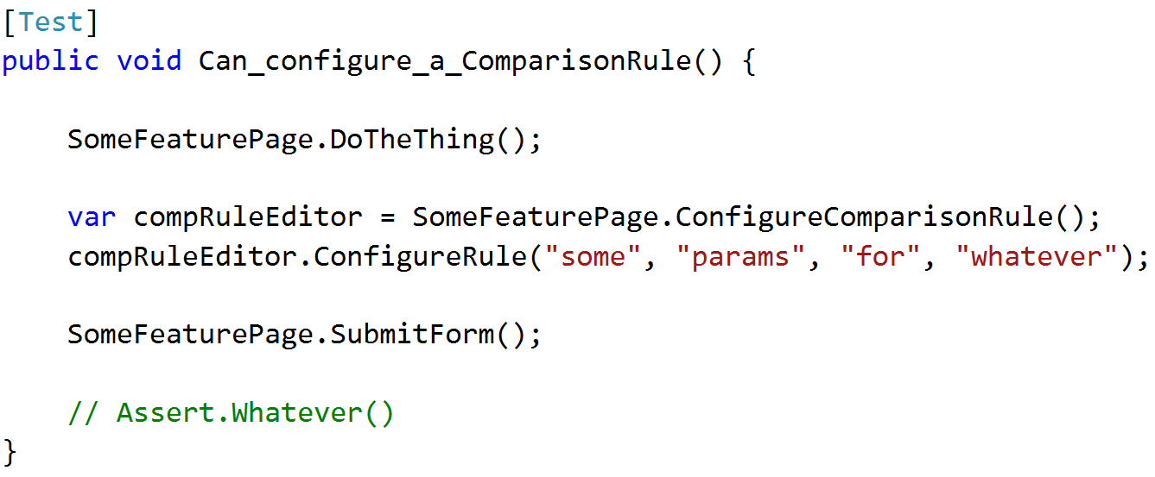
PageObject (it’s not just for “pages”!)
Notes:
I want to wrap up this section on PageObjects with one last comment: Even though this is called the “PageObject” pattern, it doesn’t have to be used at the page level. You can create a PageObject for any significant element in your UI.
For example, we have this concept in our app called a Comparison Rule and we use them on many different features. The comparison rule editor is implemented as a modal popup that is displayed, collects some complex information from the user, and then saves that data as JSON to a hidden form field.
Even though that modal popup isn’t a “page”, we still encapsulate the functionality exposed by that modal into its own PageObject so that it’s easy to reuse. In this example, we call a method on the main PageObject and that method returns an instance of the comparison rule editor PageObject. The test can then interact with that modal to do whatever it needs.
You can apply this pattern for a single page application as well. In a single page app you still have separate contexts or views that the page can be in, so you could create a PageObject for each of those contexts.

Slide 48
Setting up a UI test
Initial State
Initial Navigation
Assert()
Who's Logged In?
Notes:
A few slides ago I stated that every UI test needs to consider these 4 things.
The PageObjects that we create handle or facilitate three of the four:

Slide 49
Setting up a UI test
Initial State
Initial Navigation
Assert()
Who's Logged In?
Notes:
They provide the API that the test code uses to automate the browser and make the assertions

Slide 50
Setting up a UI test
Initial State
Initial Navigation
Assert()
Who's Logged In?
Notes:
They handle the navigation to the page in question using the GoToPage() pattern I showed you

Slide 51
Setting up a UI test
Initial State
Initial Navigation
Assert()
Who's Logged In?
Notes:
Reusing the LoginPage object gives us an easy way to specify which user context each test should use

Slide 52
Setting up a UI test
Initial State
Initial Navigation
Assert()
Who's Logged In?
Notes:
That brings us to the very first thing that you’ll need to think about when writing a UI test, which is what data needs to exist in the system in order for your test to execute, and how does that data get there?

Slide 53
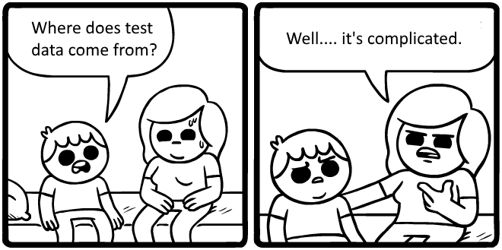
Notes:
The answer is that it’s complicated. And it’s even more complicated if you have a complicated data model to begin with.
As an example, the main product that my team develops is in the licensing and credentialing space. One of the things that we can do in our product is configure the workflow that an applicant goes through become a licensed practitioner in a field such as hair dressing, nursing, or nuclear engineering.
As you might imagine, these workflows can be very complex. Applicants need to fill out an application form that collects lots of different data, they need to pay different types of fees, other people might need to conduct background checks or review the applications in different ways, and all of this stuff needs to be configurable because it varies widely from credential to credential.
The data entry forms that a user has to fill out during this process are a key feature of the system, and we decided that they needed to be covered with UI tests.
As we started writing more and more UI tests for those features we very quickly realized that test data management would be a crucial to keeping our costs under control.

Slide 54
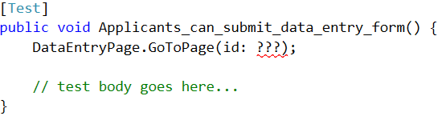
Test Data Dilemma
Notes:
As an example, pretend that we want to write a UI test for one of the data entry forms that my system can display.
Obviously, one of those forms has to exist in the database before we can write the test, so the first decision that we have to make is whether our test should render a pre-existing form that’s already been configured in the database, or whether that test should create a brand new data entry form as part of the test itself.

Slide 55
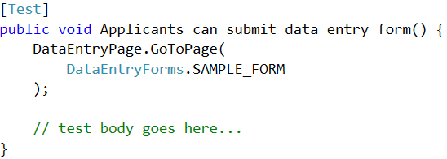
Test Data Dilemma: Pre-staged data
Notes:
Let’s say that developers on our team have a local database that’s built up from a standard baseline that is checked into source control and already has sample data in it.
If that database already has a data entry form created, then we can just create a constant that references the ID of that pre-existing record, and then the test is super easy to write.
The data already exists so there’s no real setup to do, and we can jump right into the test itself.

Slide 56
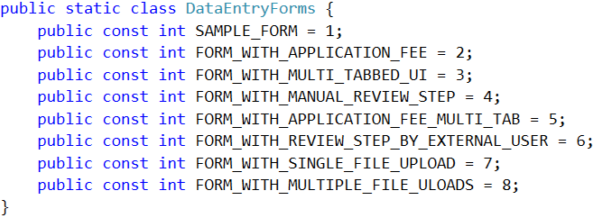

Test Data Dilemma: Pre-staged data
Notes:
In the beginning this will be easy to do because the amount of pre-staged data will be very small.
Unfortunately, things rarely stay simple over time. Eventually we’re going to write more tests, and some of those tests are going to need different things.

Slide 57
Test Data Dilemma: Pre-staged data
Notes:
Maybe there’s one test that deals specifically with fees and needs to have one specific configuration,

Slide 58
Test Data Dilemma: Pre-staged data
Notes:
and maybe there’s another test that deals with a very specific UI layout,

Slide 59
Test Data Dilemma: Pre-staged data
Notes:
And yet another test that covers a specific workflow process.
The programmers writing those tests will do the logical thing and they’ll create new data entry forms in the baseline database, they’ll configure them to meet the needs of their test, and then they’ll push the updated snapshot or test data script into source control, and they’ll add new IDs to our list of constants.

Slide 60
Test Data Dilemma: Pre-staged data
Notes:
If your application is complex enough, and the number of possible permutations of this data is large, then it won’t take long before this gets out of hand.
Let’s say we have a long list of IDs like this and a new developer joins the team and needs to write a test. This new developer has a very slim chance of identifying if any of these pre-built things meets her needs. She’ll also do the logical thing and create yet another pre-built record, and over time we’ll start to see more and more duplicates in that baseline database.
Now, I made up these specific scenarios for this example, but the need to highly specify the data context for a test is quite common in a complex system, and the more “pre-existing special cases” that you create, the harder it’s going to be to maintain that data.

Slide 61
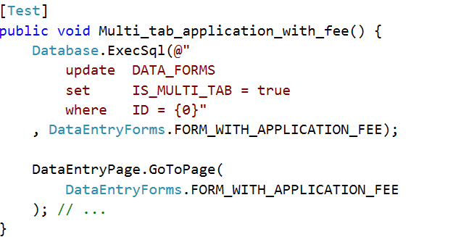
Test Data Dilemma: Pre-staged data
Notes:
Another approach would be to maintain a smaller set of pre-existing special cases, and then have each test modify one of those pre-existing things to match the test-specific needs.
For example, we could write a bit of SQL that takes an existing record with some of the characteristics we need, modify the other properties as needed, and then continue with the test.
This does reduce the number of permutations of pre-built data, but it’s a really bad idea in practice. Each test is now making permanent changes to shared global data, and that’s bad. You might get different results if you run the tests in different sequences, and it’s really hard to manage these tests because you never really know exactly what state the test data will be in when the test runs.

Slide 62
Each test should create its own test data
Notes:
For those reasons, I am a diehard believer that each test should create its own test data.
It should make the fewest possible assumptions about the state of the database, and it should be precise and explicit about which properties of that data its creating are relevant to the test.
This is probably the one principle that is most responsible for the successes my team has had with our automated tests. I think that this is crucial to managing a large and complex test suite over time.

Slide 63
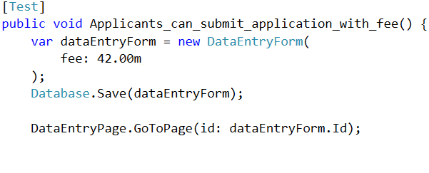

Creating test-specific data
Notes:
Let’s go back to that pretend test we’re trying to write, and instead of using pre-existing data, let’s have the test create the data that it needs on the fly.
Here’s an example of what that might look like:

Slide 64
Creating test-specific data
Notes:
We’ll need to create the data entry form in memory

Slide 65
Creating test-specific data
Notes:
… we’ll need to customize it to match the requirements of the test…

Slide 66
Creating test-specific data
Notes:
… and then we’ll need to save it to the database so that the UI test can access it.
The good news is that this test is now totally independent of the others, but there's still a problem here.

Slide 67
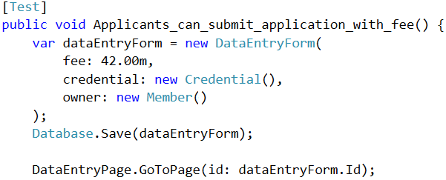
Creating test-specific data
Notes:
If I were to make this sample code a little more realistic, then creating a data entry form would require this thing called a Credential as well as the Member that owns it.

Slide 68
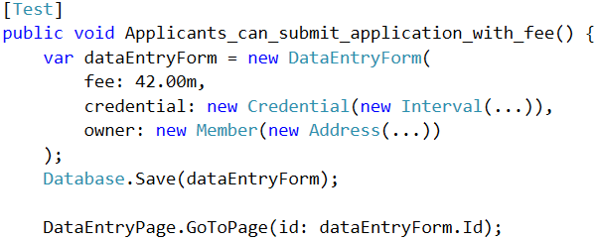
Creating test-specific data
Notes:
But it turns out that a Credential requires this thing called an Interval, and a Member requires some Address data, and each of those things may have their own dependencies.
By the time that we’ve satisfied all of the constructors we’ve had to specify a ton of data that is totally irrelevant to the outcome of our test.

Slide 69
Creating test-specific data
Notes:
These values that we had to specify are noise; they make the test harder to write and harder to read by obscuring the data that do matter to the test outcome.
Those noise values also make our tests brittle because if any of these constructors get changed in the future, this test is going to need updated as well, even if those changes have no logical bearing on the test outcome.

Slide 70
Creating test-specific data
Notes:
And of course, all of this code here is only for creating the in-memory object graph; we still need to push this thing into the database, which means we might need to deal with foreign key constraints and make sure that things are created in the correct sequence.
And if the database assigns any IDs, we'll need to update the in-memory objects accordingly.

Slide 71
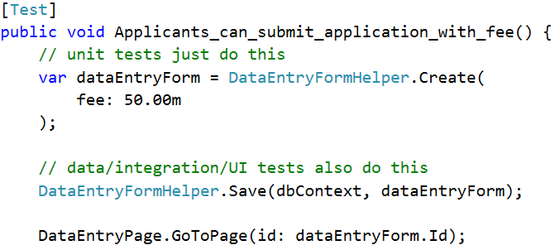
Creating test-specific data
Notes:
So obviously, it can be hard to create test-specific data.
To make it easier, we’ve created a library of data creation helpers that make it much simpler to construct test data. This is what they look like:
For every entity Foo in our system there is a class called FooHelper that exposes a Create method.

Slide 72
Creating test-specific data
Notes:
The create method exposes every piece of data that can be customized as an optional argument. When tests call the Create method, they only specify values that impact the test outcome.
The helpers provide reasonable defaults for any property that wasn’t explicitly specified in the test and then return a fully-constructed object, with all of its dependencies in a valid state and representing a valid business configuration.

Slide 73
Creating test-specific data
Notes:
If we’re writing a Data, integration, or UI test, we’ll call a second helper method, Save(), to persist those in-memory objects to the database.
This Save() method is what ensures that things are saved in the correct sequence to satisfy all of the foreign keys, and that all of the in-memory objects get updated to reflect any primary key values that are assigned by the database.
We call these objects “Test Helpers” and the really nice thing about this approach is that we use the exact same technique to create test data in all of our tests. We can create in-memory objects with one line of code and persist them with another. And when we add new things to our data model, we don’t need to update tons of tests; we just update the helper, provide a default value for the new thing, and that’s it.
This isn’t the only way to create test data. There are libraries and frameworks that will give you a generic API for building test objects, and you might be able to use your existing ORM to save those things to the database. For us, rolling our own helpers has allowed us to better deal with the complexity of our data model because we can more easily provide default values that represent real-world scenarios and we can tailor the API to suit our needs.
Sometimes the best default value for Property B depends on the value of Property A. A generic, off-the-shelf library doesn’t always make it easy to implement details like that.

Slide 74

Creating test-specific data w/ Test Helpers
Don't "new up" test data by hand – use a helper!
Tests only specify the values that impact the test
Notes:
I could go on and on about this stuff, and I actually have a 60 minute talk on just this data helper pattern that we use. For today though, the key points are:
- Don’t new up test data by hand; wrap it in some API
When you create test data, only specify values that actually impact the test. Let helpers provide default values for everything else.
This image here is from a blog post by Steven Hicks and he uses the concept of Checkov’s Gun to describe this last point.
Checkov’s Gun is a principle in dramatic writing that says that all elements in a story must be relevant in some way. One of Checkov’s quotes boils down to “if in the first act you have hung a pistol on the wall, then in the following act it should be fired”. It means that if you show something to the audience, it should be relevant to the story.
In terms of testing, if you specify a value when creating test data, that value should impact the test. If it does not, then it’s distracting and confusing. This is really, really important and helps keep your tests short, clean, and readable.

Slide 75
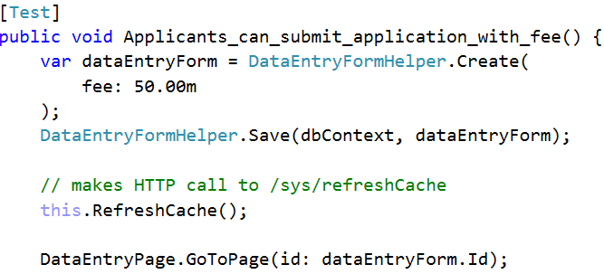
Creating test-specific data
Notes:
There’s one other problem that you might run into when creating data in the body of each test, and that’s caching. If the website is caching data, and your tests are making changes to that data behind the scenes, you’re going to need some way to refresh that web cache before accessing the data through the UI.
We’ve addressed this by creating an endpoint in our app that will refresh the cache, and we’ve added a “refreshCache” method to our base test class. Any test that creates data of a cached type can call this method to issue an AJAX request to that endpoint to synchronize everything.

Slide 76
Pre-existing data
Tests easier to write / harder to maintain
Managing the database is a PITA
Data created per-test
Tests easier to maintain
Painful when tests need to change data
Data creation helpers are a must!
Teardown / rollback scripts are necessary
Notes:
Here are your two options when it comes to test data.
Using existing data may seem easy at first, but managing that data set as it grows is really hard. This is also a bad approach when your tests need to modify or delete data becase one test might modify the data that another test depends on.
Writing each test to create its own test data is usually the better approach.
Tests easier to read and understand w/out global data
Good library of data creation helpers makes it easy to do
Teardown methods or drop/create scripts to restore your database to known clean state on demand.
We’ve been doing it this for years and it’s one of the best decisions we made on this project. The Test Helpers and automation scripts weren’t free and take some effort to maintain, but they are absolutely worth it. I don’t think any specific pattern that we follow contributes more to our success than this.

Slide 77
Do not use side effects of one test as the starting point for another!
Notes:
Using pre-existing data is one anti-pattern that will make your UI tests not fun to write.
Another anti-pattern is using the side effects of one test as the starting point for another.
For instance, say your app lets users create and edit Widgets. It might seem like a really good idea to write the tests like this:

Slide 78
Test Data anti-pattern
Submit "New Widget" form
Load & Submit "Edit Widget" form
Submit "Delete Widget" form
Notes:
First, write a test that navigates to the New Widget form and submits it, to create a new Widget.
Next, write a test that navigates to the Edit screen for the widget that you just created, and validates that the edit screen works.
Finally, write a 3rd test that deletes that Widget
And truthfully, if those were the only 3 tests that you wrote for that feature, it’s a decent and pragmatic approach. This nice, clean little package is self-contained, covers a logical progression within the application, it doesn’t depend on pre-existing data, and it cleans up after itself at the end.
The problems creep in when you start adding additional tests and that nice, clean little package gets bloated.

Slide 79
Test Data anti-pattern
Submit "New Widget" form
Load & Submit "Edit Widget" form
Submit "Delete Widget" form
Use Widget
Notes:
Presumably, Widgets have some purpose in the system beyond the CRUD screens, so next you’ll probably want a test that goes to a completely different part of the system and uses that new Widget in some way.
The easy thing to do is just insert that test between the Edit and Delete case, so it can use the same widget you already created. And since developers are lazy, this is what most developers will do in this case.

Slide 80

Test Data anti-pattern
Submit "New Widget" form
Load & Submit "Edit Widget" form
Submit "Delete Widget" form
Use Type 1
Widget
Notes:
Later on, because software evolves, you add a new property to Widgets called “Widget Type”, and this property has some major impact on the UI.
Let’s say that Widgets default to “Type 1”, so your initial test is now creating a Type 1 widget and your “use widget” test is now using a Type 1 widget.

Slide 81

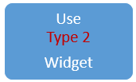
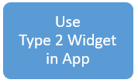
Test Data anti-pattern
Submit "New Widget" form
Load & Submit "Edit Widget" form
Submit "Delete Widget" form
Use Type 1
Widget
Notes:
But it’s also important that you test a Type 2 widget, so you clone the “use widget” test, write a little SQL in the test setup that updates it to be a Type 2 widget, and now you have two different tests that cover both widget types.
And then you still end with the Delete.
In terms of overall test coverage this is pretty good, but it’s no longer a nice, neat little package. And if we keep following this pattern as we add more and more features it very quickly becomes a brittle, hard to maintain ball of mud.

Slide 82
Test Data anti-pattern
Submit "New Widget" form
Load & Submit "Edit Widget" form
Submit "Delete Widget" form
Use Type 1
Widget
Notes:
Tests written like this are hard to understand because the only way to understand the starting point for one test is to understand the cumulative effect of all the tests that came before it.

Slide 83
Test Data anti-pattern
Submit "New Widget" form
Load & Submit "Edit Widget" form
Submit "Delete Widget" form
Use Type 1
Widget
Notes:
If any of these tests fails for any reason, every test that runs after it could fail as well. This sort of coupling between tests makes the suite as a whole much harder to maintain.

Slide 84
Test Data anti-pattern
Submit "New Widget" form
Load & Submit "Edit Widget" form
Submit "Delete Widget" form
Use Type 1
Widget
Notes:
This approach also prevents you from running your tests individually. UI tests are slow and you will find yourself wanting to run a smaller subset of them in order to shorten the feedback cycle. But if you’ve written your tests like this, then your only real option is to run them as a group.
My advice is that you should never chain feature level tests together. If you want to do an end-to-end scenario test that covers a multi-page use case, that’s great! But do it as a single, self-contained test, and use it only to validate that end to scenario; you should still go ahead and create individual, self-contained feature tests that cover all the different steps along the way.

Slide 85
Writing Resilient Tests Use test-specific IDs, classes, & data attributes to simplify locators
Notes:
At this point I’ve shown you how we use the PageObject pattern to organize our tests and how we use the Test Helper pattern to manage test data.
For the last part of this session I want to talk about writing more resilient UI tests.
When we first started writing UI tests, people tried to write the test code without making any changes to the UI code. When the HTML was complex, and the test needed to be very specific about what is was referencing, we ended up with PageObject references like this.

Slide 86
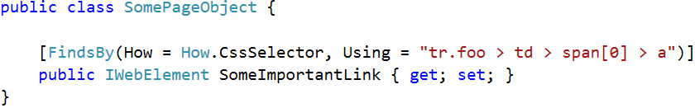
Complex selectors are NOT fun!
Notes:
This is looking for a link that is the direct child of the first span that is the direct child of a td that is the direct child of a table row with a specific class.
Hopefully you can already see why this would be brittle, because even a tiny change to the HTML structure, such as changing this span to a div, could break every test that uses this PageObject.
To avoid things like this, we encourage developers to modify the UI code to make it easier to test.

Slide 87
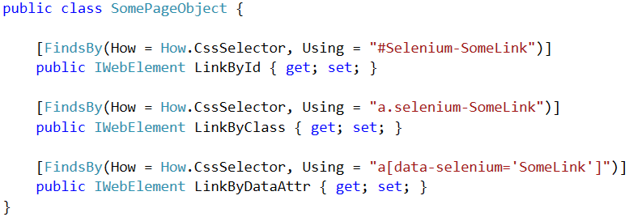
Use test-specific CSS classes & IDs
Notes:
One way of doing that is to create specific IDs, classes, and data attributes that are used ONLY for UI tests.
When we do this, include a “selenium” prefix which indicates that these IDs, classes, and data elements are not to be used for styling or any functional javascript. This prefix means these things are ONLY to be used by the tests.
We encourage that separation because it makes it far less likely that a designer is going to inadvertently break your tests when they update the styles, or that another programmer will break your tests when they refactor the client-side javascript. The selenium prefix is a very clear indicator that these things matter to the test code.
Every once in awhile you may run into some scenario that makes it hard to use test-specific markers. In that case, if you can’t bind your PageObjects directly to a selenium-specific marker, you should pick a locator that is going to be the most resilient to change.

Slide 88

Locator Tree of Life
Fruit at the top is bitter;
eat in moderation only!
Fruit at the bottom is tasty and healthy – eat your fill!
Notes:
To do this, you can use this concept called the Locator Tree of Life.
The locator tree of life is basically a way of thinking about locators that encourages you to write more maintainable code. The idea is that fruit at the bottom of the tree is tasty and healthy, but as you move higher and higher the fruit becomes bitter and you should look for alternatives or eat it very sparingly.
The locators at the bottom, such as ID, classname, and data attribute locators, tend to be easier to use and more resilient to change.
Copyright: <a href='https://www.123rf.com/profile_mjak'>mjak / 123RF Stock Photo</a>

Slide 89
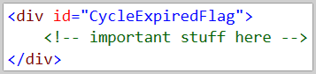
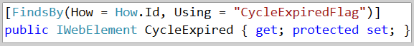
Locator Tree of Life
Fruit at the top is bitter;
eat in moderation only!
Fruit at the bottom is tasty and healthy – eat your fill!
Notes:
For example, let’s say I have this piece of HTML with an ID and a PageObject that references that ID. If a developer wants to make changes to this code, and they do a text search for this ID, they will easily locate the PageObject and be able to make the corresponding changes to it.
Copyright: <a href='https://www.123rf.com/profile_mjak'>mjak / 123RF Stock Photo</a>

Slide 90
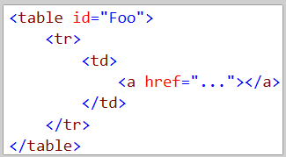
Locator Tree of Life
Fruit at the top is bitter;
eat in moderation only!
Notes:
Things get more difficult when we’re working with locators higher up the tree. Here’s another piece of HTML and a path-based locator.
Nothing about this HTML fragment suggests that adding a <div> tag to the table cell is going to break anything, and there’s no text search that a developer can run that’s going to help them figure it out.
The lack of an obvious, explicit link between the HTML structure and the PageObject is what makes this sort of locator extremely brittle.
Copyright: <a href='https://www.123rf.com/profile_mjak'>mjak / 123RF Stock Photo</a>

Slide 91
Locator Tree of Life
Use these locators w/ test-specific markers for extremely resilient tests
Notes:
As a general rule, we avoid locators based on paths, element text, index or position within a group, and all of the other complex stuff that CSS makes possible.
If you combine these low-hanging fruit with test-specific names using that “selenium” prefix, you’ll have tests that are very resilient in the face of changes to the HTML.
Copyright: <a href='https://www.123rf.com/profile_mjak'>mjak / 123RF Stock Photo</a>

Slide 92
Tips & Tricks Create test harnesses for components, then UI-test the harness
Notes:
The next technique I want to talk about is the concept of a test harness for your UI code.
Because my system is so dynamic and configurable, it’s not always easy to get to a page or context where a given feature is used.
For instance, we support lots of different types of data input fields on our data entry forms, and some of them are pretty complex. But the only way to execute that code in the browser is to create an application process, add a data entry form to it, add a data field of the necessary type, and then log in and begin that form as a user. That’s a lot of work and the vast majority of it has nothing to do with the test itself, it’s only necessary so that we can navigate to a page where the code we want to test is actually executed.
To make this easier, we create test harnesses for all of our UI components.
The first thing we do, of course, is to “componentize” our features in the first place. This is a really important design concept irrespective of UI testing and provides lots of other benefits, and it also makes things easier to test.
The idea is that whenever you have a nontrivial piece of UI, you should design or package it as a “component” or helper so that it can be more easily re-used. Even if the UI is heavily coupled to the functionality of a single page, and you don’t think you’d ever re-use it on a different page, wrapping that UI into a component makes it easier to reason about and makes it easier to test.

Slide 93
Components + Test Harnesses = WIN
Html.YourComponent(…)
$("#something").yourComponent({…})
Vue.component("yourComponent", {…})
Notes:
It really doesn’t matter what stack you’re using, there’s a way to encapsulate your UI stuff into reusable pieces.
In ASPNET MVC you can wrap an HTML Helper around it (example)
You can turn it into a jQuery plugin
Most front-end frameworks and libraries like React, VUE.js and Knockout support components as a 1st class design concept

Slide 94
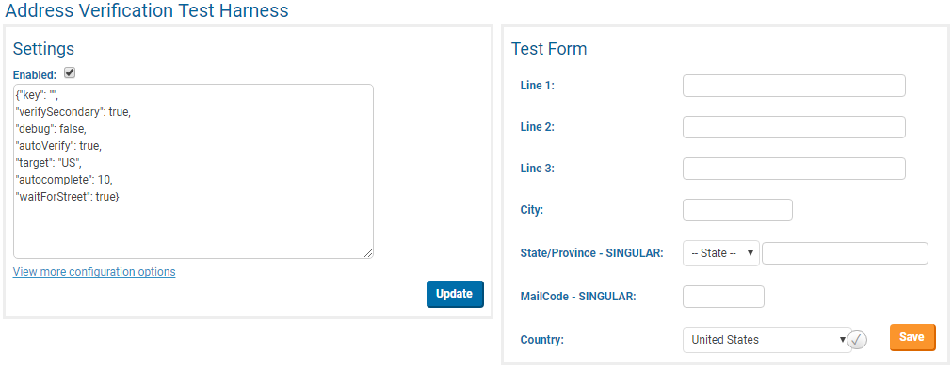
Components + Test Harnesses = WIN
Notes:
The second thing we do is create a page for each component that invokes it in isolation from the business logic.
This is a screenshot of an actual test harness we created recently. We added a 3rd party address verification service to the system and we created a component that wraps that 3rd party library and adapts it to our needs. We then created this test harness which contains a section on the left for tinkering with the configuration, and then a section on the right that renders the component using that configuration.
This is super helpful for manual testing, but it’s also really easy to automate because we don’t have to deal with any test data, or navigating through any complex set of steps just to get to a page that contains this component. We can navigate directly to the test harness, set the configuration we want to test, and then test it.
These test harnesses also serve as technical documentation for developers which has also proven to be quite useful.

Slide 95
Components + Test Harnesses = WIN
At least 1 test covers the in-app happy path
All other "if <condition> then <outcome>" tests use the harness
Notes:
Obviously, just like with unit tests, testing a component in isolation doesn’t actually tell us that it will work for real, so our practice is to write at least 1 test that covers the component in some sort of in-app happy path scenario.
The purpose of this test isn’t to confirm any specific piece of functionality, but just to make sure that everything is wired up together.
Once we have that, all other tests are against the harness.

Slide 96
Takeaway #1 Have a deliberate test strategy; use UI tests to plug specific gaps left by lower-level tests
Notes:
To wrap up, I want to summarize the main things I want you to remember when you leave here.
First, you should create a deliberate test strategy for each feature, and you should endeavor to validate business rules and logic with lower-level tests. Write UI tests only to plug specific gaps in the strategy.
And if you find yourself testing what feels like “business logic” via the UI, look for ways to refactor the code so that you can unit test that logic instead.
Make this strategy a first class part of your process. This is something you should be talking about regularly with your team.

Slide 97
Takeaway #2 Use the PageObject pattern to create an app-centric API for tests to consume
Notes:
Second, use the PageObject pattern to create an application-centric API for your tests to consume.
By encapsulating the DOM locators and page functionality within these objects you can isolate your test logic from the HTML implementation and make your tests much easier to maintain.

Slide 98
Takeaway #3 Tests create their own data using helpers; Remember Chekhov's Gun!
Notes:
Lastly, each test should create its own test data, rather than relying on pre-existing data.
This might seem a little painful at first, but it gets a lot easier if you create a library of data creation helpers that you can use for ALL of your tests, unit, integration, and UI.
And when you use those helpers to write your tests, make sure that you only have to explicitly specify the values that actually impact the test outcome. Your helpers should create logical defaults for everything else.

Slide 99
Have fun testing!
Have a deliberate test strategy – only UI test what you can't unit test instead
Use PageObjects to create application-centric, page-specific test APIs
Tests create their own data using helpers; remember Chekhov's Gun!
github.com/spetryjohnson
@spetryjohnson / seth@petry-johnson.com
Notes:
And that’s it! Here are those 3 takeaways for your screen shotting pleasure, plus the best ways to get ahold of me if you have questions, comments, stock tips, etc.
Thank you for your time, and have fun testing!

